Slide 1
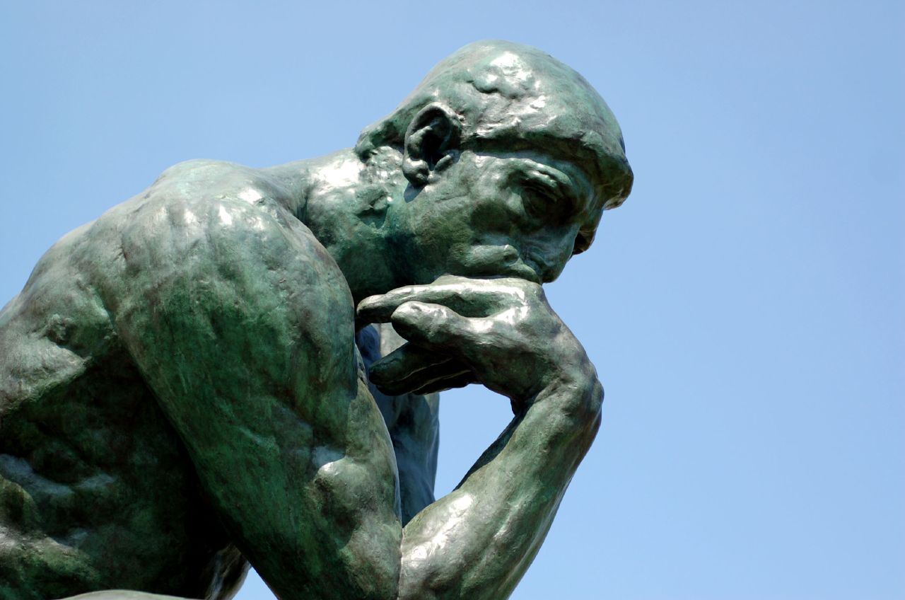
“Behold, I thought …”
2 Kings 5:1-14
(All Scriptures NASV1995 unless otherwise noted)

Slide 2

The Back Story
Before entering the promised land, Moses warned God’s people of the consequences of unfaithfulness.
“Furthermore, you shall not intermarry with them; you shall not give your daughters to their sons, nor shall you take their daughters for your sons. For they will turn your sons away from following Me to serve other gods; then the anger of the Lord will be kindled against you and He will quickly destroy you.” (Deuteronomy 7:3-4)

Slide 3
The Back Story
This account takes place during the period of the divided kingdom.
God was displeased with Israel’s constant rebellion and idol worship and cursed them by blessing their enemies.
“So the anger of the Lord was kindled against Israel, and He gave them continually into the hand of Hazael king of Aram, and into the hand of Ben-hadad the son of Hazael.” (2 Kings 13:3)

Slide 4
The Back Story
During this period of the divided kingdom:
Israel was constantly at war with Aram (Syria).
  1 Kings 20 and 22
God delivered Ben-hadad, king of Aram (Syria) into the hands of Ahab, king of Israel, but he made a covenant with him and let him go.
  1 Kings 20:34
God promised Ahab he would pay for that mistake with his life, which he did, in battle against Aram (Syria). This is where 1 Kings ends.
  1 Kings 20:42 / 1 Kings 22:34-38

Slide 5
The Back Story
In 2 Kings 1 through 4:
Ahaziah the son of Ahab dies and Jehoram becomes king of Israel.
  2 Kings 1:17
Elijah the prophet is taken up by a whirlwind to heaven and Elisha becomes his successor.
  2 Kings 2:11-15
Elisha counsels the kings of Judah, Israel, and Edom in their destruction of Moab.
  2 Kings 3:18
Elisha speaks for God and performs miracles.
  2 Kings 4:1-44

Slide 6
2 Kings 5:1
“Now Naaman, captain of the army of the king of Aram, was a great man with his master, and highly respected, because by him the Lord had given victory to Aram. The man was also a valiant warrior, but he was a leper.” (2 Kings 5:1)

Slide 7
2 Kings 5:1
What do we know about Naaman?
Captain of the army of Ben-hadad, king of Aram (Syria)
Highly respected
Great and honorable man
Mighty man of valor, a valiant warrior
The Lord had given him victories over Israel
BUT, he was a leper, a virtual death sentence
(Mentioned by name by Jesus in Luke 4:27)

Slide 8
2 Kings 5:2-5
“Now the Arameans had gone out in bands and had taken captive a little girl from the land of Israel; and she waited on Naaman’s wife. She said to her mistress, ‘I wish that my master were with the prophet who is in Samaria! Then he would cure him of his leprosy.’ Naaman went in and told his master, saying, ‘Thus and thus spoke the girl who is from the land of Israel.’ Then the king of Aram said, ‘Go now, and I will send a letter to the king of Israel.’ He departed and took with him ten talents of silver and six thousand shekels of gold and ten changes of clothes.” (2 Kings 5:2-5)

Slide 9
2 Kings 5:2-5
Based on these verses, Naaman either …
Showed great faith for a Syrian, or
Was ready to try anything under the circumstances
  Believed the young Israelite captive’s words
  Showed humility to visit enemy’s prophet
  Convinced Ben-hadad, king of Aram (Syria) to write a letter to Jehoram, king of Israel

Slide 10
2 Kings 5:6-8
“He brought the letter to the king of Israel, saying, ‘And now as this letter comes to you, behold, I have sent Naaman my servant to you, that you may cure him of his leprosy.’ When the king of Israel read the letter, he tore his clothes and said, ‘Am I God, to kill and to make alive, that this man is sending word to me to cure a man of his leprosy? But consider now, and see how he is seeking a quarrel against me.’ It happened when Elisha the man of God heard that the king of Israel had torn his clothes, that he sent word to the king, saying, ‘Why have you torn your clothes? Now let him come to me, and he shall know that there is a prophet in Israel.’”
(2 Kings 5:5-8)

Slide 11
2 Kings 5:6-8
After reading Ben-hadad’s letter asking Jehoram to cure Naaman’s leprosy, Jehoram is upset.
Jehoram, king of Israel, considers Ben-hadad’s request completely unreasonable.
He knows that only God can cure leprosy.
He is convinced Ben-hadad is picking a fight.
Elisha sends word to Jehoram to send Naaman to him.

Slide 12
2 Kings 5:9-10
“So Naaman came with his horses and his chariots and stood at the doorway of the house of Elisha. Elisha sent a messenger to him, saying, ‘Go and wash in the Jordan seven times, and your flesh will be restored to you and you will be clean.’”
(2 Kings 5:9-10)

Slide 13
2 Kings 5:9-10
Reception by Elisha
Naaman had traveled many miles
  Over 100 miles from Damascus to Samaria
  Approximately 65 miles from Samaria to Gilgal
Elisha did not even meet him, but instead sent his servant
Told him to go dip seven times in the dirty Jordan River

Slide 14
2 Kings 5:11
“But Naaman was furious and went away and said, ‘Behold, I thought, “He will surely come out to me and stand and call on the name of the Lord his God, and wave his hand over the place and cure the leper.”’”
(2 Kings 5:11)

Slide 15
2 Kings 5:11
Naaman’s response (in different translations):
“Behold, I thought the prophet would come out and call upon the Lord and strike his hand over me and I would be cleansed of the leprosy.” KJV
“Indeed, I said to myself, ‘He will surely come out to me, and stand and call on the name of the Lord his God, and wave his hand over the place, and heal the leprosy.’” NKJV
“Behold, I thought that he would surely come out to me and stand and call upon the name of the Lord his God, and wave his hand over the place and cure the leper.” ESV

Slide 16
2 Kings 5:12-14
“‘Are not Abanah and Pharpar, the rivers of Damascus, better than all the waters of Israel? Could I not wash in them and be clean?’ So he turned and went away in a rage. Then his servants came near and spoke to him and said, ‘My father, had the prophet told you to do some great thing, would you not have done it? How much more then, when he says to you, “Wash, and be clean’?”’ So he went down and dipped himself seven times in the Jordan, according to the word of the man of God; and his flesh was restored like the flesh of a little child and he was clean.”
(2 Kings 5:12-14)

Slide 17
2 Kings 5:12-14
Naaman’s reaction:
Furious – Did not believe Elisha the prophet
Not the reception he expected
Thought the Damascus rivers were better
Went away in a rage
Finally listened to his servants and obeyed
Upon obedience, Naaman was cured!

Slide 18
Behold, I Thought …
Related Scriptures:
“Trust in the Lord with all your heart and do not lean on your own understanding. In all your ways acknowledge Him, and He will make your paths straight.”
(Proverbs 3:5-6)
“There is a way which seems right to a man, but its end is the way of death.”
(Proverbs 14:12/16:25)

Slide 19
Behold, I Thought …
Related Scriptures:
“‘For My thoughts are not your thoughts, nor are your ways My ways,’ declares the Lord. ‘For as the heavens are higher than the earth, so are My ways higher than your ways and My thoughts than your thoughts.’” (Isaiah 55:8-9)
“I know, O Lord, that a man’s way is not in himself, nor is it in a man who walks to direct his steps.” (Jeremiah 10:23)

Slide 20
Application
We are like Naaman:
Sick with a deadly disease – sin!
Unable to cure it ourselves.
Obedience necessary for successful cure.
Can’t let our pride get in the way.

Slide 21
Application
“Behold, I thought …
… God wants me to be happy.”
“Then Jesus said to His disciples, ‘If anyone wishes to come after Me, he must deny himself, and take up his cross and follow Me.’”
(Matthew 16:24)
“For the flesh sets its desire against the Spirit, and the Spirit against the flesh; for these are in opposition to one another, so that you may not do the things that you please.”
(Galatians 5:17)

Slide 22
Application
“Behold, I thought …
… I can divorce my spouse for any reason.”
“And I say to you, whoever divorces his wife, except for sexual immorality, and marries another, commits adultery; and whoever marries her who is divorced commits adultery.” (Matthew 19:9 NKJV)
“Marriage is to be held in honor among all, and the marriage bed is to be undefiled; for fornicators and adulterers God will judge.”
(Hebrews 13:4)

Slide 23
Application
“Behold, I thought …
… Worship sounds better with instruments.”
“… speaking to one another in psalms and hymns and spiritual songs, singing and making melody with your heart to the Lord …” (Ephesians 5:19)
“Let the word of Christ richly dwell within you, with all wisdom teaching and admonishing one another with psalms and hymns and spiritual songs, singing with thankfulness in your hearts to God.” (Colossians 3:16)

Slide 24
Application
“Behold, I thought …
… I have plenty of time to obey God.”
“And He told them a parable, saying, ‘The land of a rich man was very productive. And he began reasoning to himself, saying, “What shall I do, since I have no place to store my crops?” Then he said, “This is what I will do: I will tear down my barns and build larger ones, and there I will store all my grain and my goods. And I will say to my soul, ‘Soul, you have many goods laid up for many years to come; take your ease, eat, drink and be merry.’” But God said to him, ‘You fool! This very night your soul is required of you; and now who will own what you have prepared?’ So is the man who stores up treasure for himself, and is not rich toward God.” (Luke 12:16-21)

Slide 25
Application
“Behold, I thought …
… I only need to believe.”
“… for with the heart a person believes, resulting in righteousness, and with the mouth he confesses, resulting in salvation.”
(Romans 10:10)
“Peter said to them, ‘Repent, and each of you be baptized in the name of Jesus Christ for the forgiveness of your sins; and you will receive the gift of the Holy Spirit.’” (Acts 2:38)

Slide 26
Application
“Behold, I thought …
… We are saved by faith alone.”
“You see that a man is justified by works and not by faith alone.” (James 2:24)
“For by grace you have been saved through faith; and that not of yourselves, it is the gift of God; not as a result of works, so that no one may boast. For we are His workmanship, created in Christ Jesus for good works, which God prepared beforehand so that we would walk in them.”
(Ephesians 2:8-10)

Slide 27
Application
“Behold, I thought …
… I should join the church of my choice.”
“I also say to you that you are Peter, and upon this rock I will build My church; and the gates of Hades will not overpower it.” (Matthew 16:18)
“And He put all things in subjection under His feet, and gave Him as head over all things to the church, which is His body, the fullness of Him who fills all in all.” (Ephesians 1:22-23)
“For the husband is the head of the wife, as Christ also is the head of the church, He Himself being the Savior of the body.” (Ephesians 5:23)

Slide 28
Application
“Behold, I thought …
… I should join the church of my choice.”
“So then, those who had received his word were baptized; and that day there were added about three thousand souls.” (Acts 2:41)
“… And the Lord was adding to their number (“the church” KJV) day by day those who were being saved.” (Acts 2:47b)
“Greet one another with a holy kiss. All the churches of Christ greet you.” (Romans 16:16)

Slide 29
Application
Would Naaman have been healed …
By doing nothing?
By dipping in the rivers of Syria?
By dipping 3 times in the Jordan?
By drinking water from the Jordan?
It doesn’t matter what we think.
What matters is what God commands!

Slide 30
Other Examples
Adam and Eve thought fig leaves were modest clothing:
“Then the eyes of both of them were opened, and they knew that they were naked; and they sewed fig leaves together and made themselves loin coverings.” (Genesis 3:7)
“The Lord God made garments of skin for Adam and his wife, and clothed them.” (Genesis 3:21)

Slide 31
Other Examples
Cain thought God would accept his own offering:
“… but for Cain and for his offering He had no regard. So Cain became very angry and his countenance fell. Then the Lord said to Cain, ‘Why are you angry? And why has your countenance fallen? If you do well, will not your countenance be lifted up? And if you do not do well, sin is crouching at the door; and its desire is for you, but you must master it.’ Cain told Abel his brother. And it came about when they were in the field, that Cain rose up against Abel his brother and killed him.” (Genesis 4:5-8) (see also Hebrews 11:4)

Slide 32
Other Examples
Nadab and Abihu thought God would accept their offering “which He had not commanded”:
“Now Nadab and Abihu, the sons of Aaron, took their respective firepans, and after putting fire in them, placed incense on it and offered strange fire before the Lord, which He had not commanded them. And fire came out from the presence of the Lord and consumed them, and they died before the Lord. Then Moses said to Aaron, ‘It is what the Lord spoke, saying, “By those who come near Me I will be treated as holy, and before all the people I will be honored.”’ So Aaron, therefore, kept silent.” (Leviticus 10:1-4) (see also Leviticus 16:12)

Slide 33
Other Examples
King Saul thought God would accept his burnt offering:
“But Samuel said, ‘What have you done?’ And Saul said, ‘Because I saw that the people were scattering from me, and that you did not come within the appointed days, and that the Philistines were assembling at Michmash, therefore I said, “Now the Philistines will come down against me at Gilgal, and I have not asked the favor of the Lord.” So I forced myself and offered the burnt offering.’ Samuel said to Saul, ‘You have acted foolishly; you have not kept the commandment of the Lord your God, which He commanded you, for now the Lord would have established your kingdom over Israel forever. But now your kingdom shall not endure. The Lord has sought out for Himself a man after His own heart, and the Lord has appointed him as ruler over His people, because you have not kept what the Lord commanded you.” (1 Samuel 13:11-14)

Slide 34
Other Examples
The apostle Peter thought he could save Jesus:
“From that time Jesus began to show His disciples that He must go to Jerusalem, and suffer many things from the elders and chief priests and scribes, and be killed, and be raised up on the third day. Peter took Him aside and began to rebuke Him, saying, ‘God forbid it, Lord! This shall never happen to You.’ But He turned and said to Peter, ‘Get behind Me, Satan! You are a stumbling block to Me; for you are not setting your mind on God’s interests, but man’s.’” (Matthew 16:21-23)
(See also John 18:10-11)

Slide 35
Other Examples
The apostle Paul thought he needed to kill Christians:
“So then, I thought to myself that I had to do many things hostile to the name of Jesus of Nazareth. And this is just what I did in Jerusalem; not only did I lock up many of the saints in prisons, having received authority from the chief priests, but also when they were being put to death I cast my vote against them. And as I punished them often in all the synagogues, I tried to force them to blaspheme; and being furiously enraged at them, I kept pursuing them even to foreign cities.”
(Acts 26:9-11)
“Paul, looking intently at the Council, said, ‘Brethren, I have lived my life with a perfectly good conscience before God up to this day.’” (Acts 23:1)

Slide 36
How To Obey The Gospel of Jesus Christ
Hear the word of God
(2 Thessalonians 2:14-15; James 1:21)
Believe the gospel message
(Hebrews 11:6; John 8:24)
Repent of sins
(Luke 13:3; Acts 17:30-31)
Confess Jesus Christ
(Romans 10:10; Matthew 10:32-33)
Be Baptized for Forgiveness of Sins
(Mark 16:16; Acts 2:38; Galatians 3:26-27; Romans 6:3-4)
Remain Obedient
(Matthew 7:21; Revelation 2:10; Hebrews 3:12)

